Slide 1
Implementation of a Hairpin Model Based Passive Microwave Tag Using Microstrip Structure
Dr. Shantanu Chakraborty
W. Logan Spooner

Slide 2
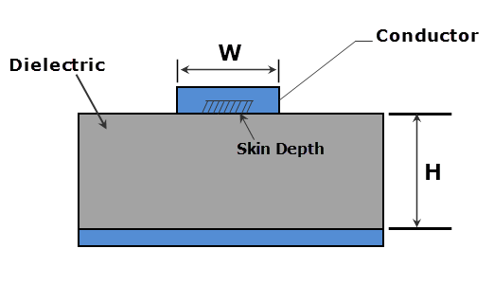
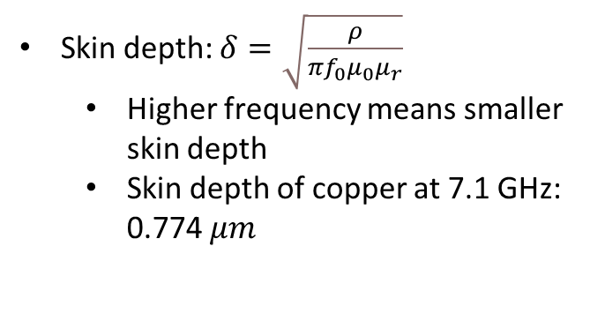
Advantages of Using Microstrip Structure
Wide range of applications as Radio-Frequency Identification (RFID)
Asset Tracking
Theft Prevention
Security Identification Systems
Cost efficiency
Can be produced with commonly available, low-cost materials
Does not require a clean room or expensive fabrication equipment
Does not involve use of any hazardous chemicals
Compact design reduces power loss due to skin depth at higher frequencies
Skin depth: $δ=\sqrt{\frac{ρ}{πf_{0}μ_{0}μ_{r}}}$
Higher frequency means smaller skin depth
Skin depth of copper at 7.1 GHz: 0.774 $μm$

Slide 3
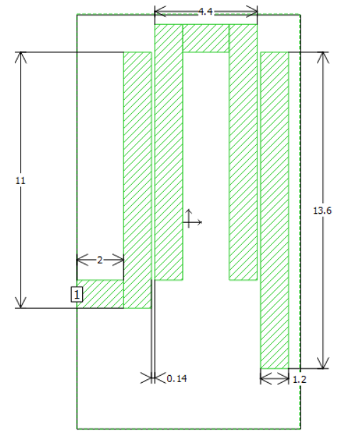
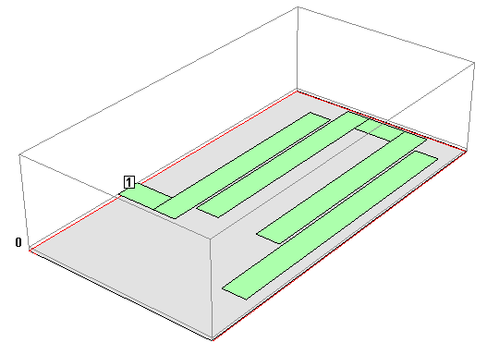
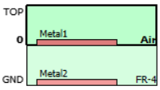
Circuit Design with Dimensions
Units in mm

Slide 4

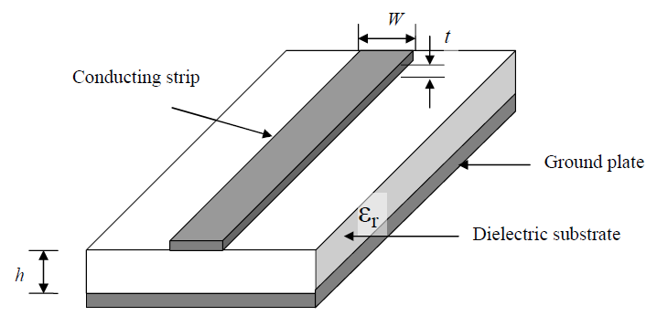

Methods
Effective Dielectric Constant:
¹$ε_{eff}=\frac{ε_{r}+1}{2}+\frac{ε_{r}−1}{2}{\left(1+\frac{10h}{w}\right)}^{−1/2}+0.468\frac{ε_{r}+0.5}{1.5}\sqrt{\frac{t}{w}}$
w= 1.2mm
t=0.03mm
h=1.6mm
$$ε_{r}≈4.4$$
$ε_{eff}≈3.4$
Effective Wavelength:
C=λ₀f λ₀=C/f
Then: $λ_{g}=\frac{λ_{0}}{\sqrt{ε_{eff}}}$ $λ_{g}=23 mm$
Design: Sonnet EM Simulation Software
Material:
FR-4 (PCB material)
Copper Tape
Precision knife
Analysis:
Used Sonnet to analyze designed RFID
Used VNA to analyze constructed RFID

Slide 5
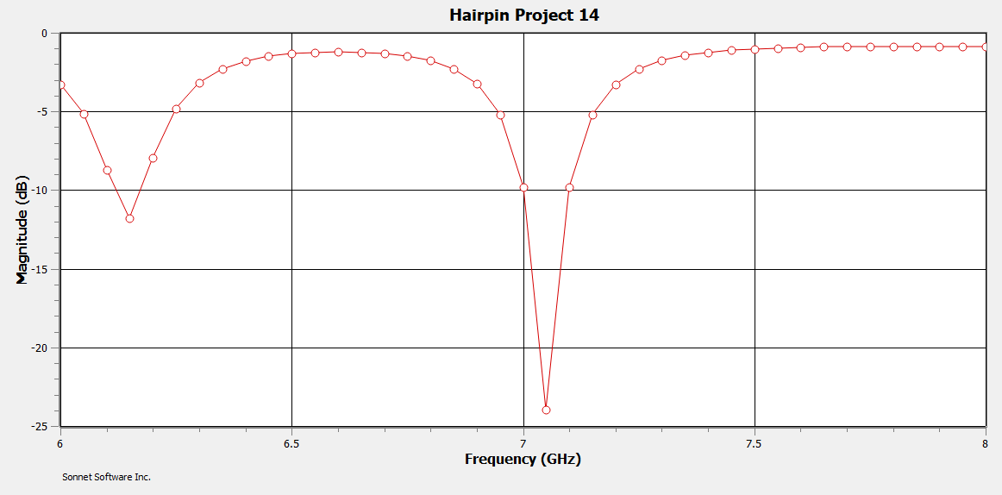
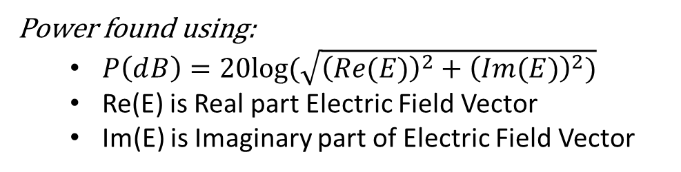
Data
Simulation Results
Experimental Results
24 dB loss at 7.05 GHz
34.599 dB loss at 7.11 GHz
Power found using:
$P\left(ⅆB\right)=20log⁡(\sqrt{{\left(Re(E)\right)}^{2}+{\left(Im(E)\right)}^{2})}$
Re(E) is Real part Electric Field Vector
Im(E) is Imaginary part of Electric Field Vector

Slide 6
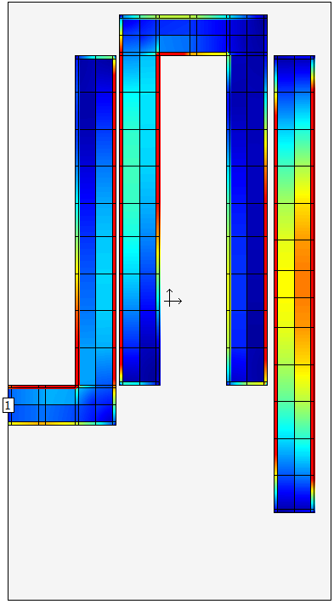
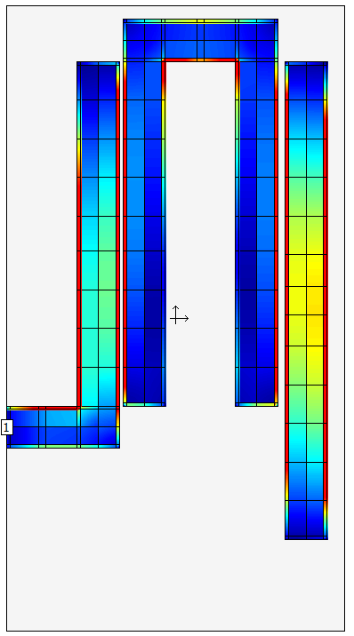
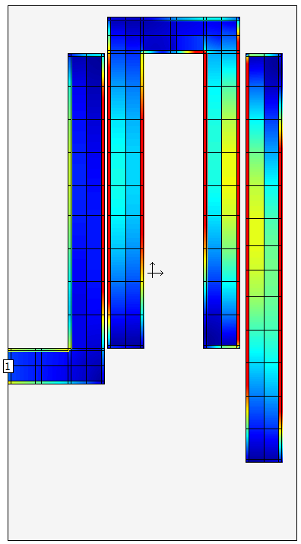
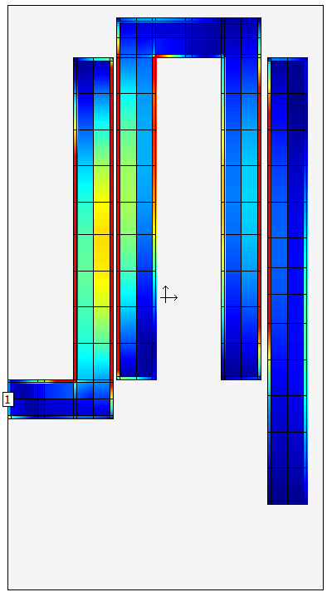
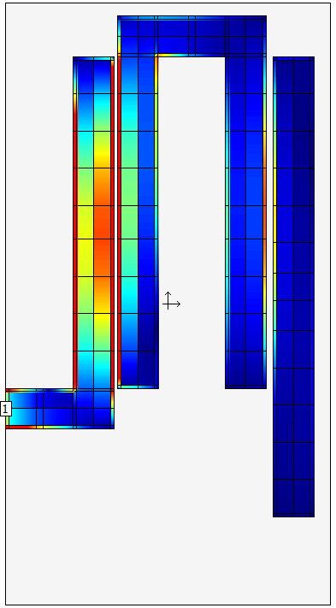
Current Density View
6.0 GHz
6.5 GHz
7.0 GHz
7.5 GHz
8.0 GHz

Slide 7
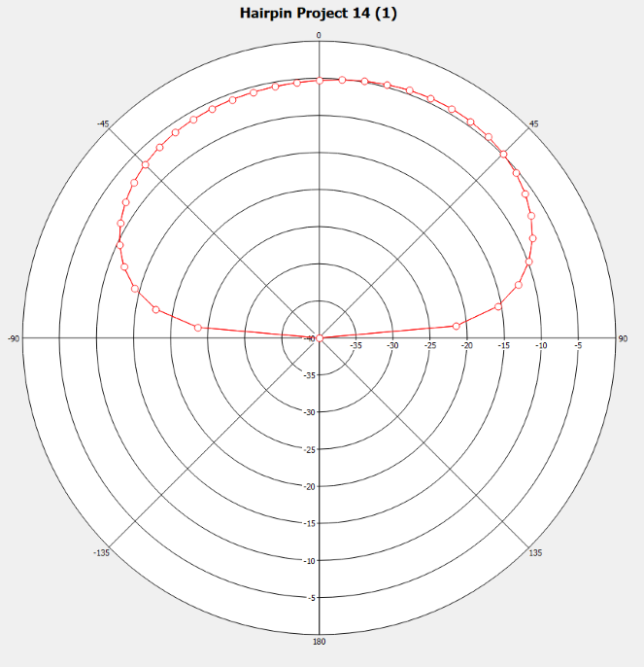
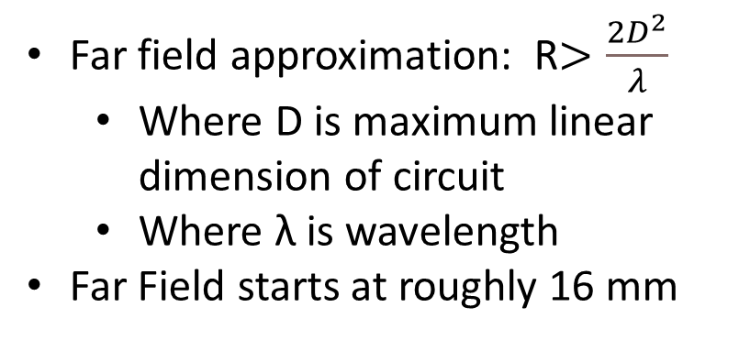
Far Field Radiation View
Far field approximation: R$>\frac{2D^{2}}{λ}$
Where D is maximum linear dimension of circuit
Where λ is wavelength
Far Field starts at roughly 16 mm

Slide 8
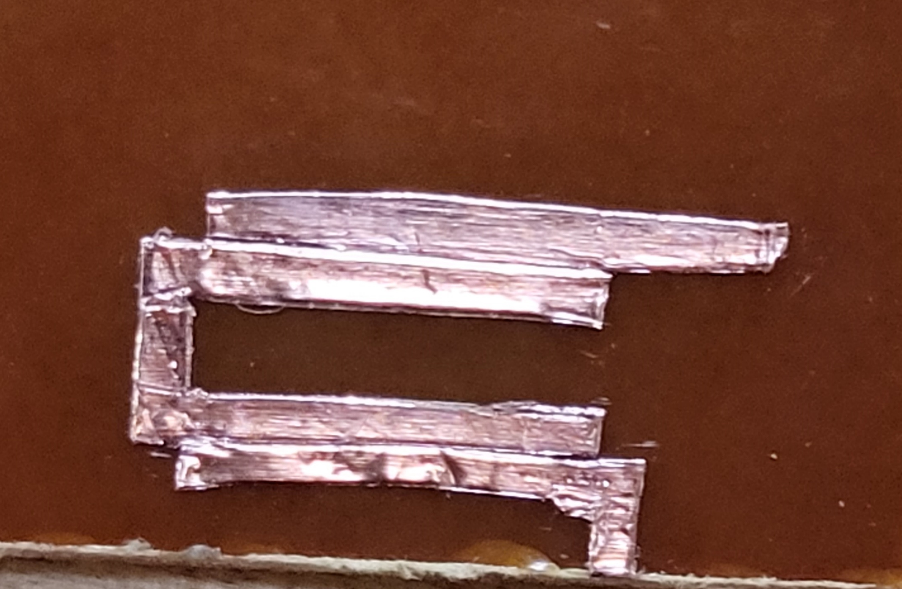
Final Product

Slide 9
Citation
: J. Bahl and R. Garg, "Simple and accurate formulas for a microstrip with finite strip thickness," in Proceedings of the IEEE, vol. 65, no. 11, pp. 1611-1612, Nov. 1977, doi: 10.1109/PROC.1977.10783.
Microstrip Diagram: https://www.google.com/url?sa=i&url=https%3A%2F%2Fwww.researchgate.net%2Ffigure%2FA-basic-microstrip-structure_fig2_303406192&psig=AOvVaw1MryOuwc7s-o5AWnIQwXNU&ust=1647995638690000&source=images&cd=vfe&ved=0CAwQjhxqFwoTCOCC-6a82PYCFQAAAAAdAAAAABAO
https://www.pasternack.com/t-calculator-skin-depth.aspx
Papatheologou, T., Smolders, A. B., & Johannsen, U. (2011). A hairpin antenna-in-package concept for RFID tag applications. In Radio and Wireless Symposium (RWS), Phoenix, AZ, USA, 16-19 Jan. 2011 (pp. 54-57). Institute of Electrical and Electronics Engineers. https://doi.org/10.1109/RWS.2011.5725445

